Slide 1
CubCourses
By Akhil Devarasetty and Brandon Jia

Slide 2

What Is It?
High school management system
Support administrators, teachers, and students manage various aspects of the school's operations
class enrollment
Grading
club memberships
faculty management
The system will have three main user roles:
Student
Teacher
Administrator
This Photo by Unknown Author is licensed under CC BY-SA

Slide 3

Primary Use Case
Students viewing grades
The student logs into the system.
The student navigates to the View Classes use case, which displays all available classes.
The student selects a specific class from the list.
The teacher has used the Assign Grades use case, the student can see their grade for that class
This Photo by Unknown Author is licensed under CC BY-NC

Slide 4
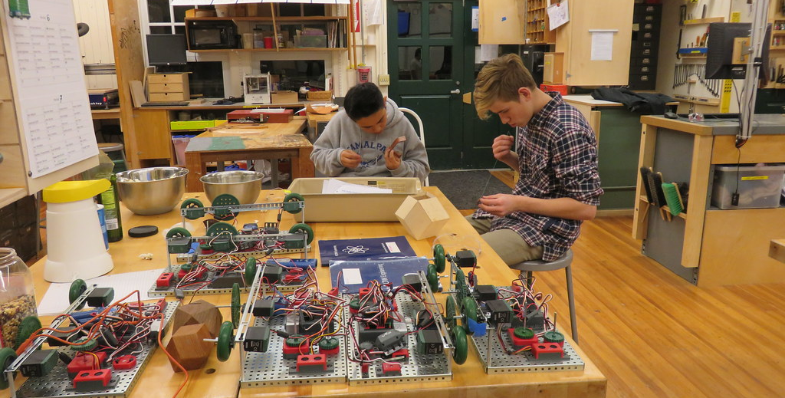

More Student Use Cases
View Classes
Enroll in Classes
View Clubs
Join Clubs
This Photo by Unknown Author is licensed under CC BY
This Photo by Unknown Author is licensed under CC BY-SA

Slide 5
Other Use Cases
Teacher
Receives Bonuses
Assign Grades
Advise Clubs
Administrator:
Manages Faculty
Manages Students
Grant Bonuses

Slide 6
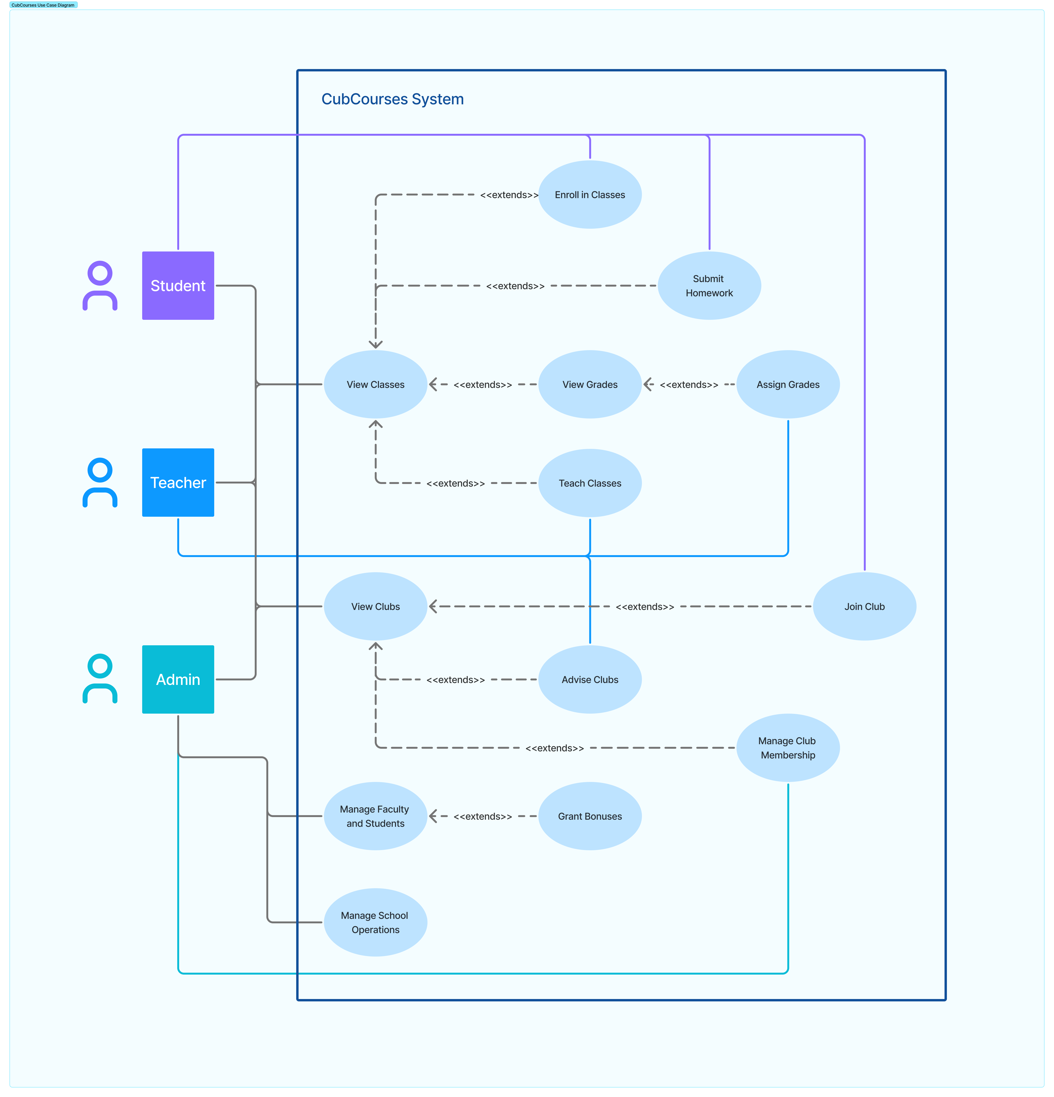
Use Case Diagram

Slide 7
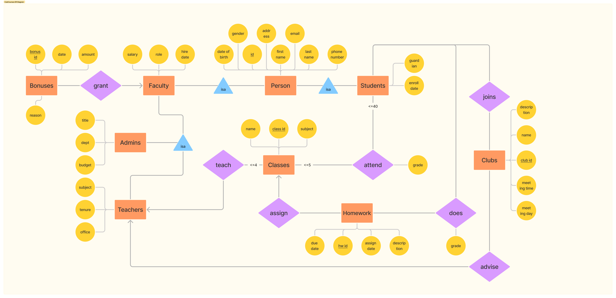
ER Diagram

Slide 8
Relational Schema
Person(id, first_name, last_name, phoneNum, email, address, gender, dob)
Faculty(faculty_id, hire_date, role, salary)
Student(student_id, guardian, enroll_date)
Administrator(admin_id, position_title, department, budget_responsibility)
Teacher(teacher_id, subject, tenure, office)
Class(class_id, name, teacher_id, subject)
Grades(grade_id, grade, grade_date, comments)
Clubs(club_id, teacher_id, name, description, meeting_time, meeting_day)
Bonuses(bonus_id, date, amount, reason)
Teaches(class_id, teacher_id)
Advises(club_id, teacher_id)
Attends(student_id, class_id)
Joins(student_id, club_id)
Granted(bonus_id, faculty_id)
Assign(homework_id, class_id)
DoesHomework(homework_id, student_id, grade)

